Slide 1


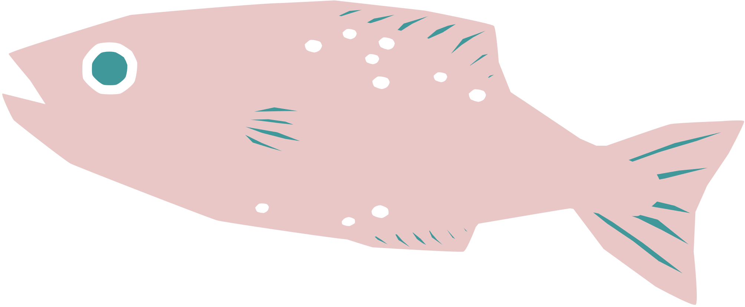
YUNA :PET APPLICATION
Graduation Project​
2023-2024

Slide 2




Our Team
20-01186
20-00088
20-00536
Sara Rabie Ahmed
Shahd Abd Elmoez
Alaa Khaled Rashed
20-00532
20-01137
Doaa Anter Kotb
Malk Haitham Mostafa
20-00552
20-01114
Soha Nagy Khedr
Aya Yasser Helmy
Supervised By​
DR.
ENG.
Rodaina Abdelsalam
Nader Emad

Slide 3

Outline
1
Introduction​
7
Current progress
Statistics
Methodology of Proposed Approach
2
8
3
Problem Statement
9
Time Plan
Related Work​
4
10
Future Work
Features
5
11
Conclusion
6
Research Objectives
References
12

Slide 4
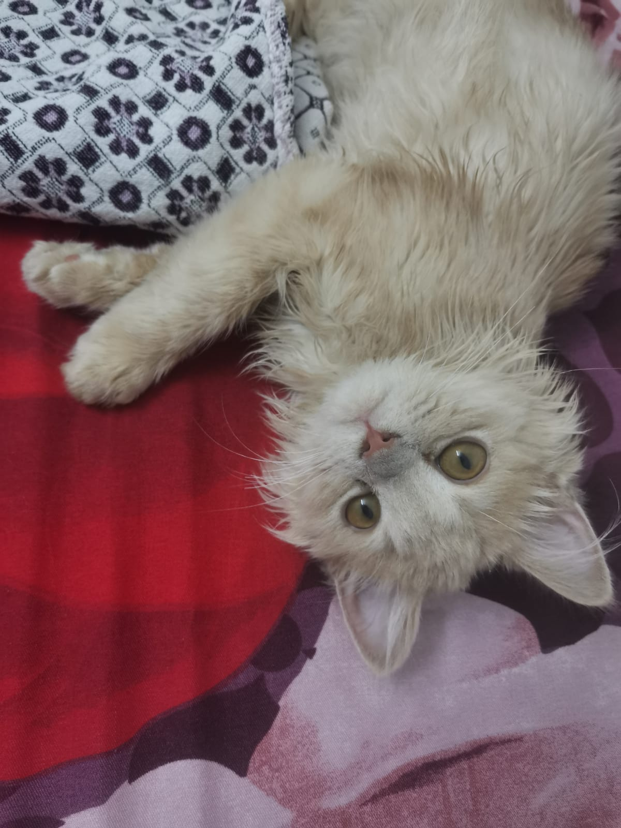
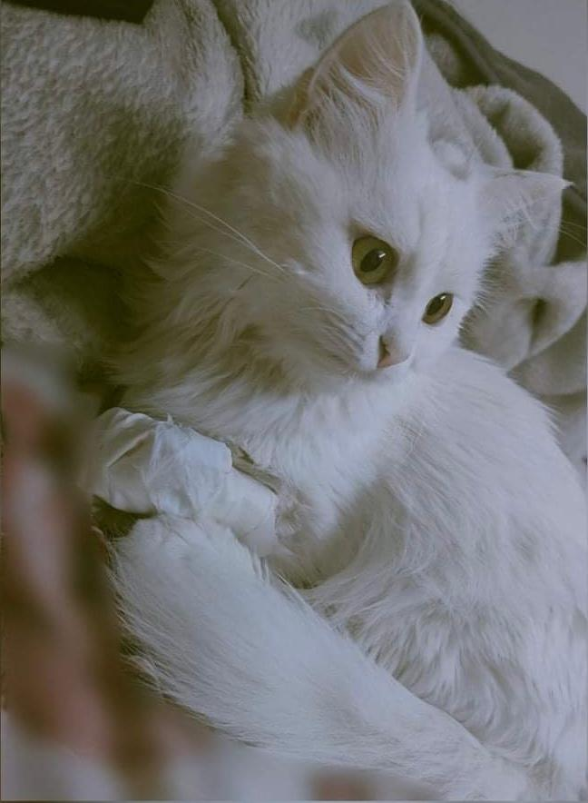
True stories about cat suffering

Slide 5

Introduction
In a world where pets are family, meet the Yuna Pet App. Seamlessly understanding and organizing pet care. Welcome to a smarter, simpler way to nurture your pet's well-being.

Slide 6

Why did we choose pets?

Slide 7

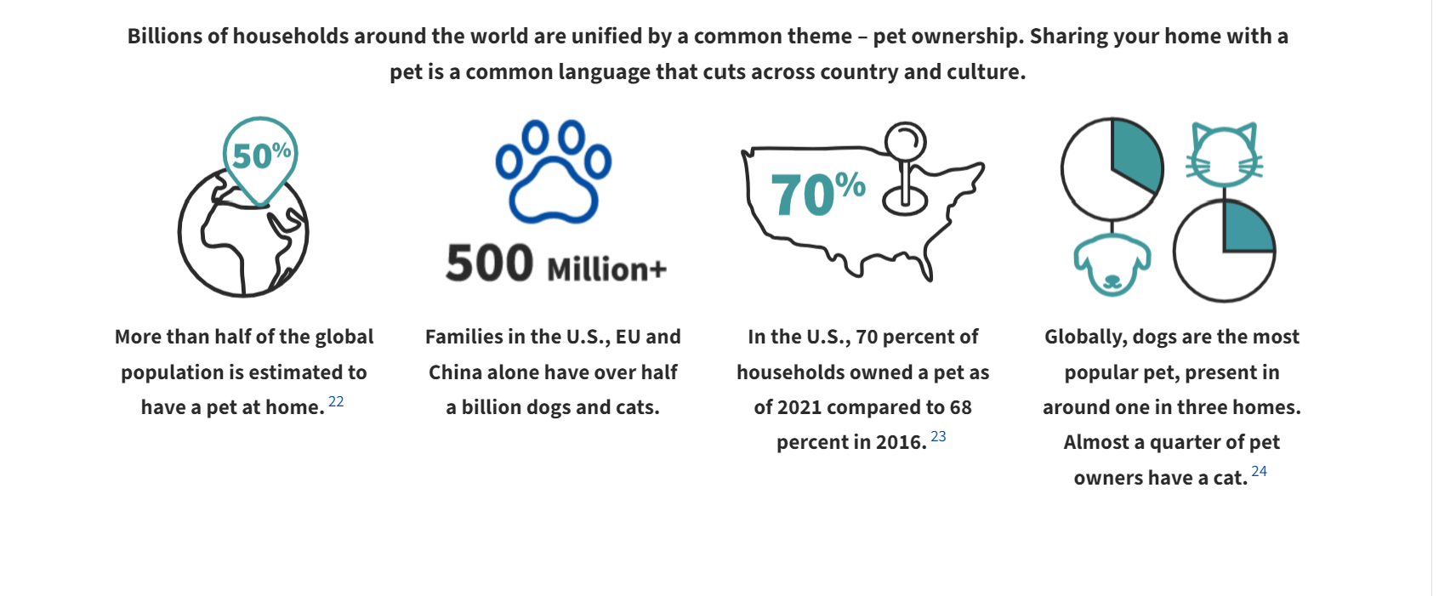

Slide 8

Why did we choose dogs and cats in particular?

Slide 9
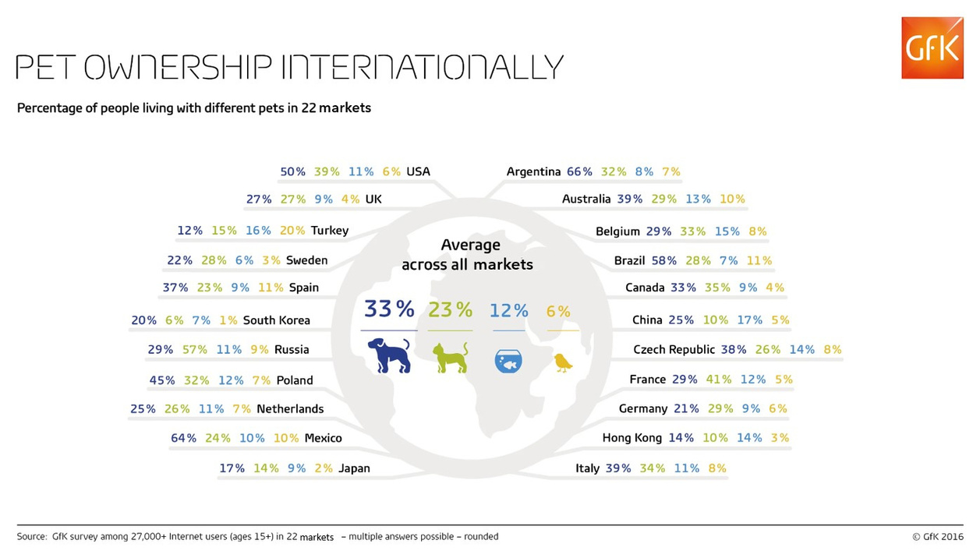
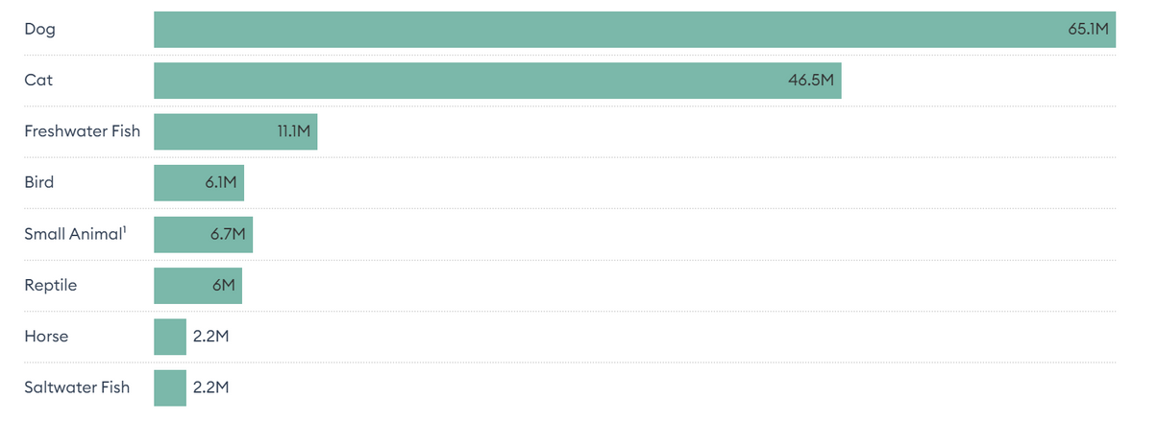

Statistics for pet ownership in some countries of the world

Slide 10

why do pets improve our health?

Slide 11
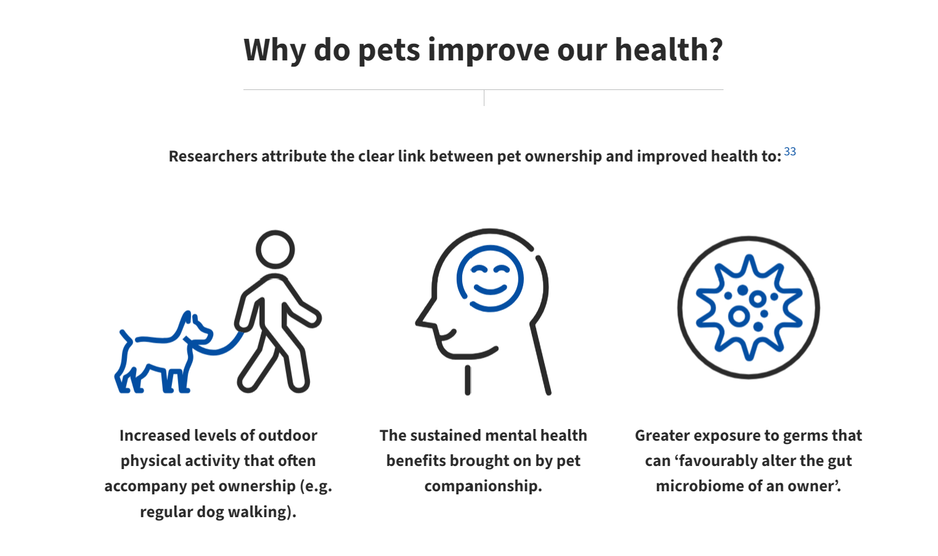


Slide 12



Problem Statements:
PROBLEM 1
PROBLEM 2
Lack of accessible and detailed information about various pet species and their specific needs, leading to uninformed pet care practices.
"Identifying skin diseases in dogs is challenging, potentially leading to delayed treatment. Pet owners may struggle to recognize signs of disease in their pets' stool."
PROBLEM 3
Busy schedules can result in overlooked pet care responsibilities.

Slide 13
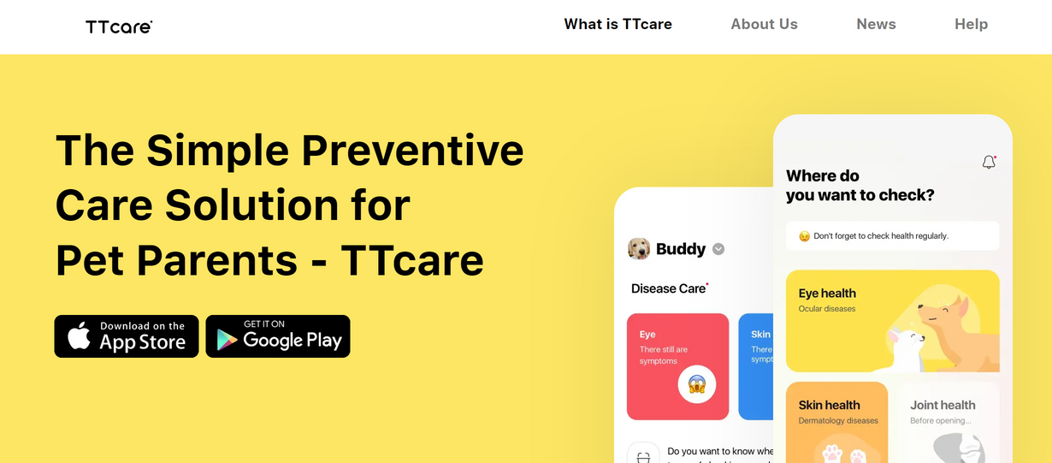
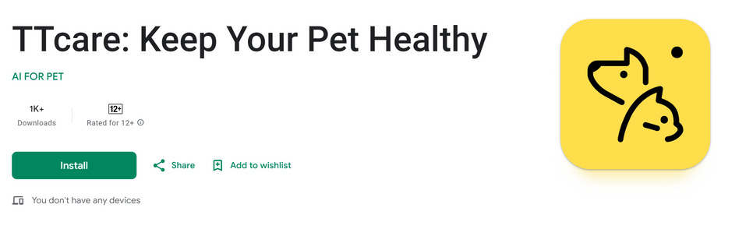
RELATED WORK​
TTCARE APP
HOW TTCARE WORKS
Simply take pictures of your pet's eyes and skin to check their health with the help of our AI.
ADVANTAGES
SIMPLE
Just download the app and you are then
ready to check the health of your dog(s) or cat(s).
Smart
AI will detect abnormal symptoms early
with an accuracy level of over 90%.
Innovative
World's first mobile application that
identifies symptoms of diseases.
Recognized
Patent registered medical device software approved by
the Korean Ministry of Agriculture, Food and Rural Affairs.

Slide 14
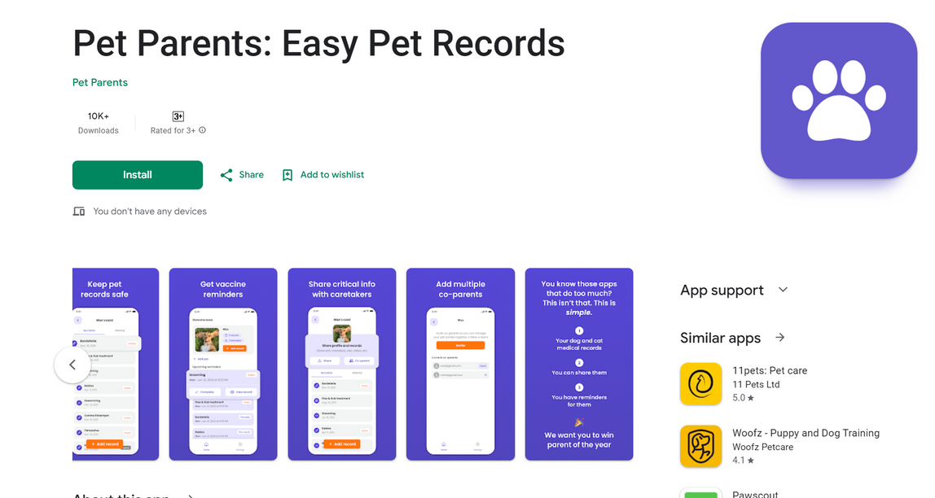
RELATED WORK CONT.​
PET PARENTS
It is an application that treats the pet owner like a father and provides important reminders regarding the pet
ADVANTAGES
ADDS VACCINE REMINDERS.
AND GIVES YOU EASY WAYS TO SHARE CRITICAL INFO WITH CARETAKERS.

Slide 15

Features
feature
# 1
feature
# 2
feature
# 3
Develop a feature with AI that discovers and provides detailed information about different types of Dogs and Cats
Integrating an AI system that detects potential health issues in dogs by analyzing the characteristics of their feces and their skin diseases.
Create a user-friendly reminder system for mealtimes, check-up dates, and vaccinations based on user input

Slide 16
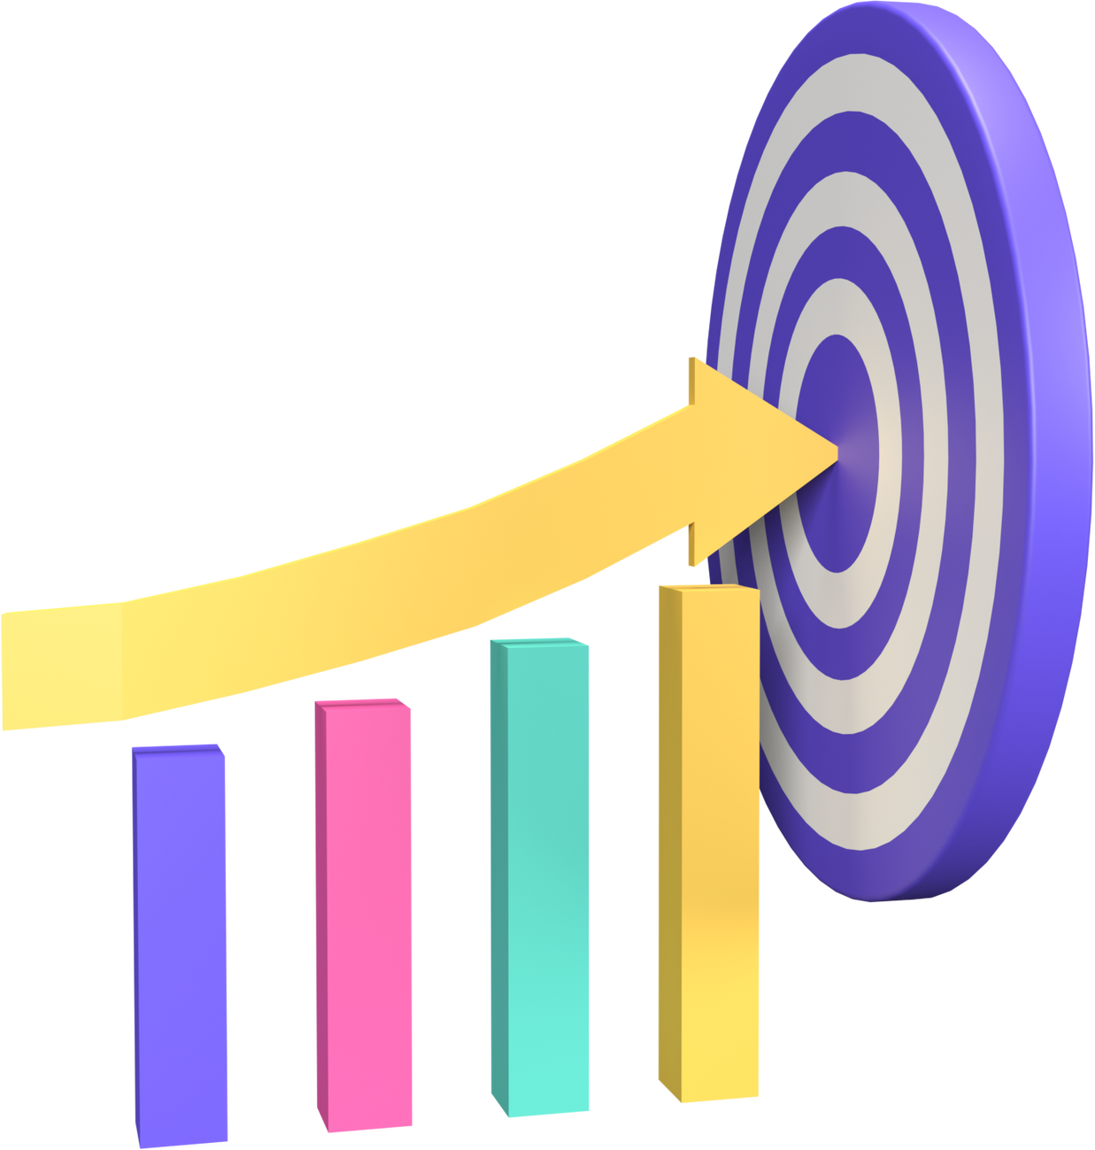
RESEARCH OBJECTIVES

Slide 17


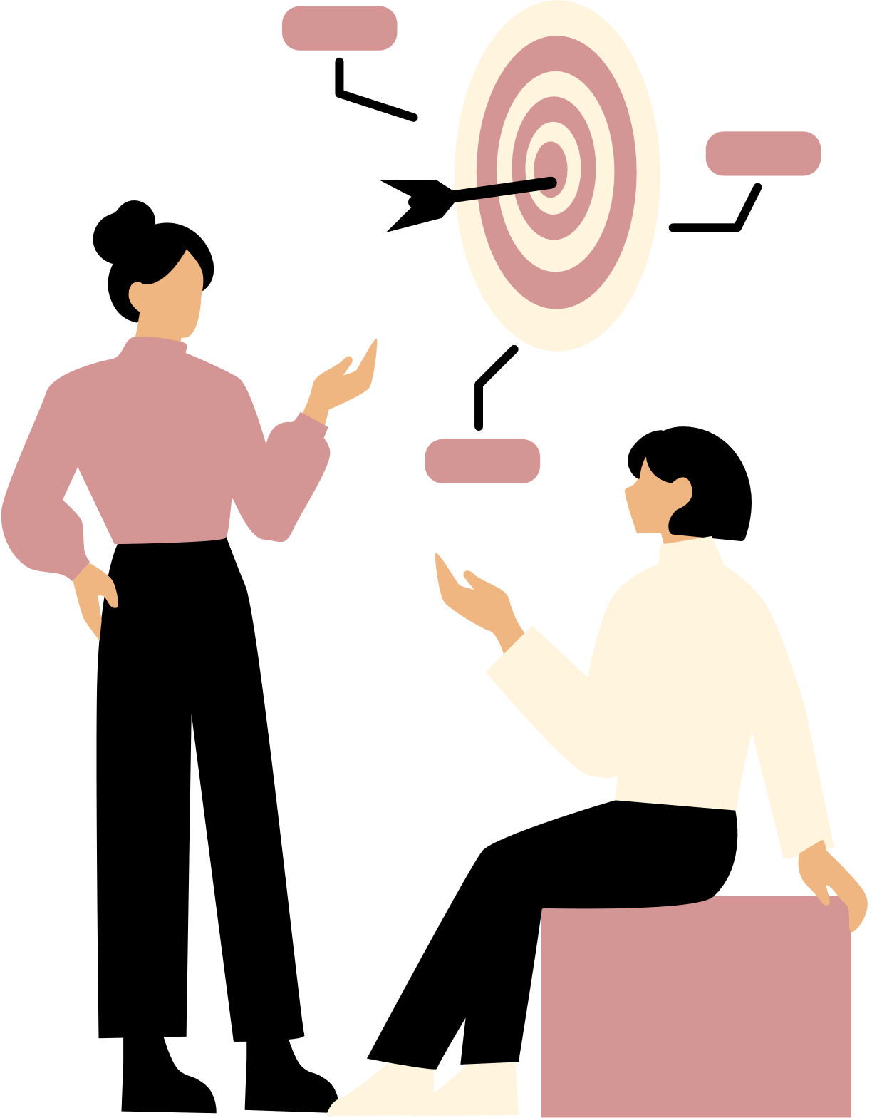
Goals
As mentioned earlier, our goal is to assist pet owners in learning more about their pets' behavior and health without the need for professional guidance.
To reach this goal we must:
Design the frontend and backend of the application:
splash page
add pet page
welcome pages
camera page
login/register pages
detect page

Slide 18
Design the frontend and backend of the application cont.
detect result page
reminder page
pet profile page
home page
disease detect page
user page
setting page

Slide 19

CURRENT PROGRESS
1
welcome page
login page
2
3
Register Page ​
Home page
4
define page
5

Slide 20
6
camera page
7
result page
my pets pages
8
9
detect disease page
10
reminder page
setting page
11

Slide 21
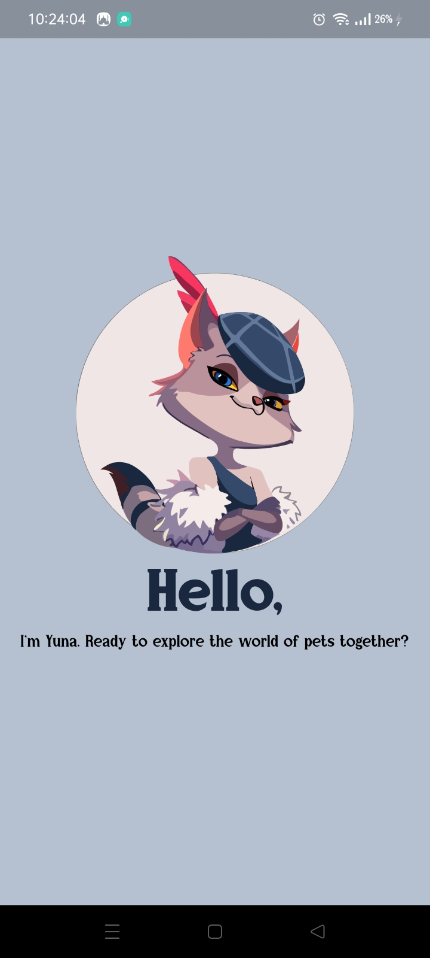
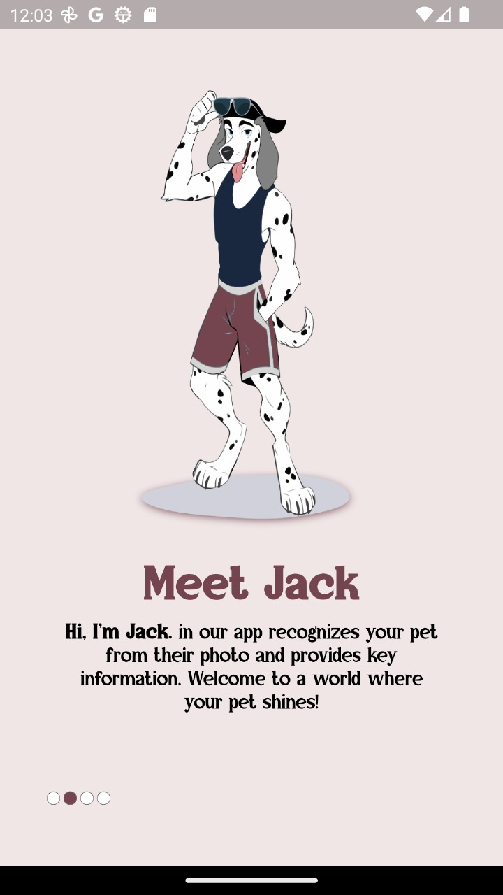
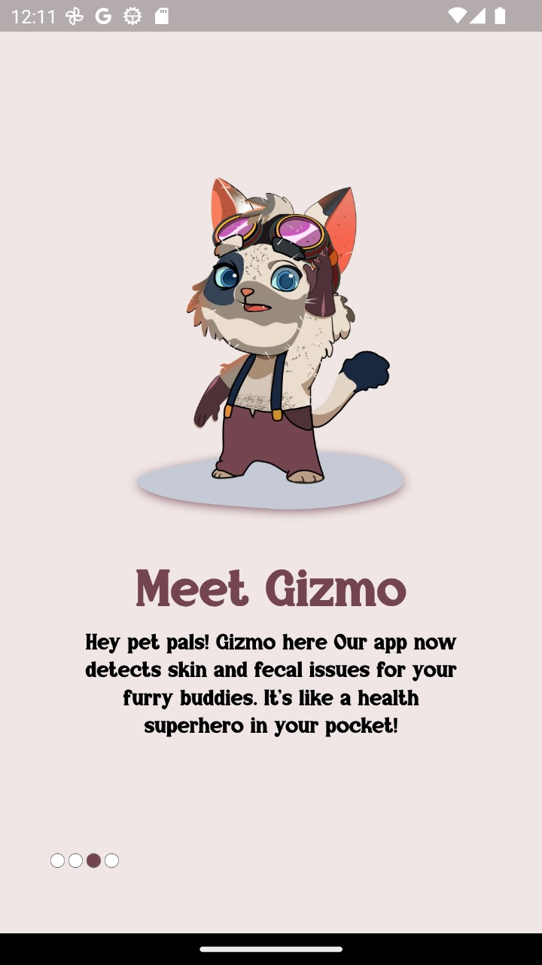
Welcome page

Slide 22
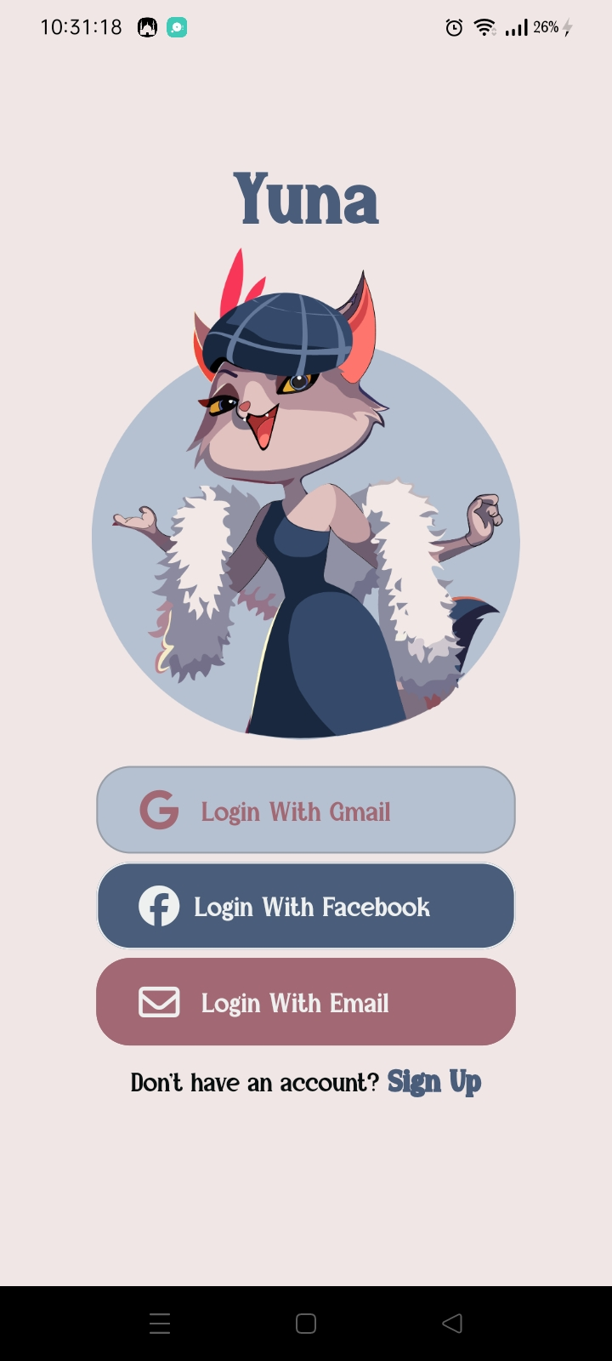
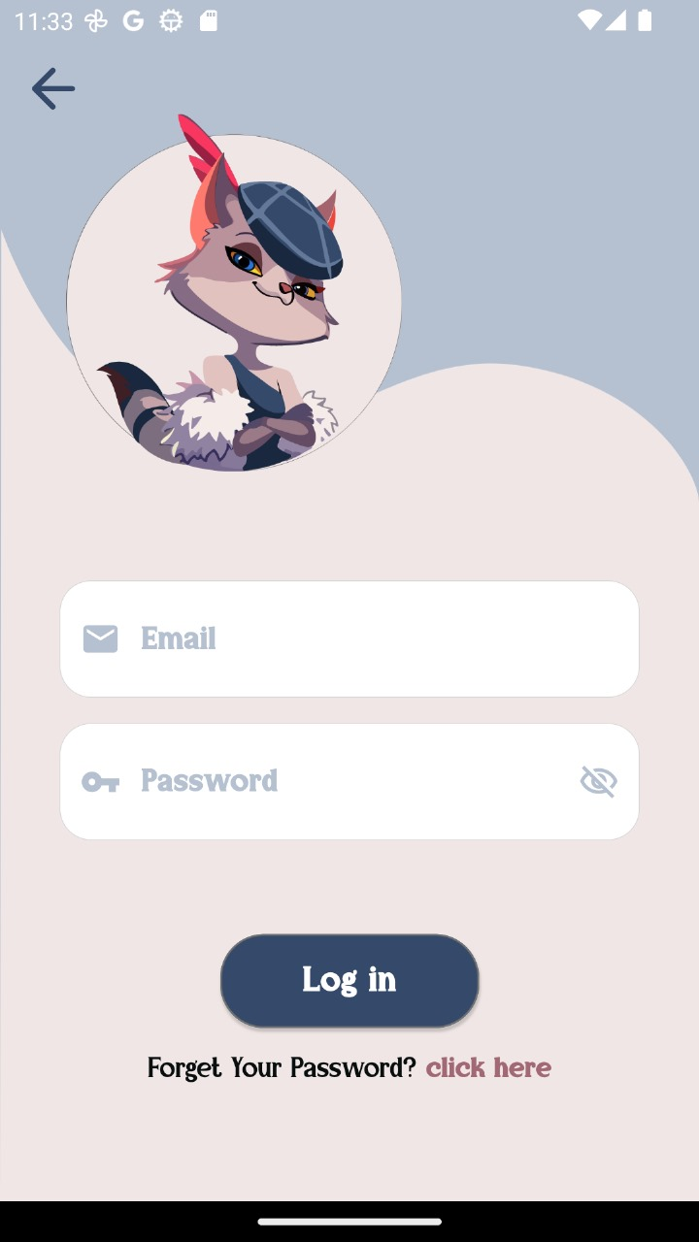
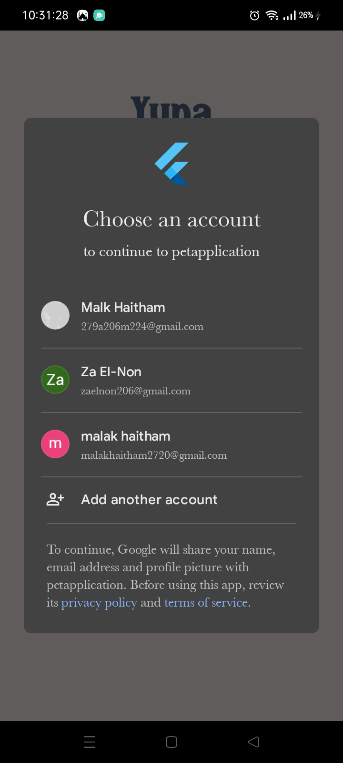
Login pages

Slide 23
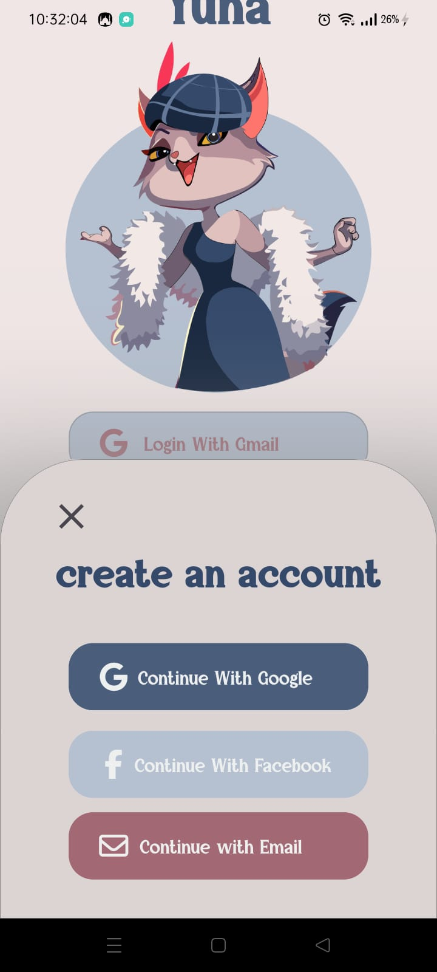
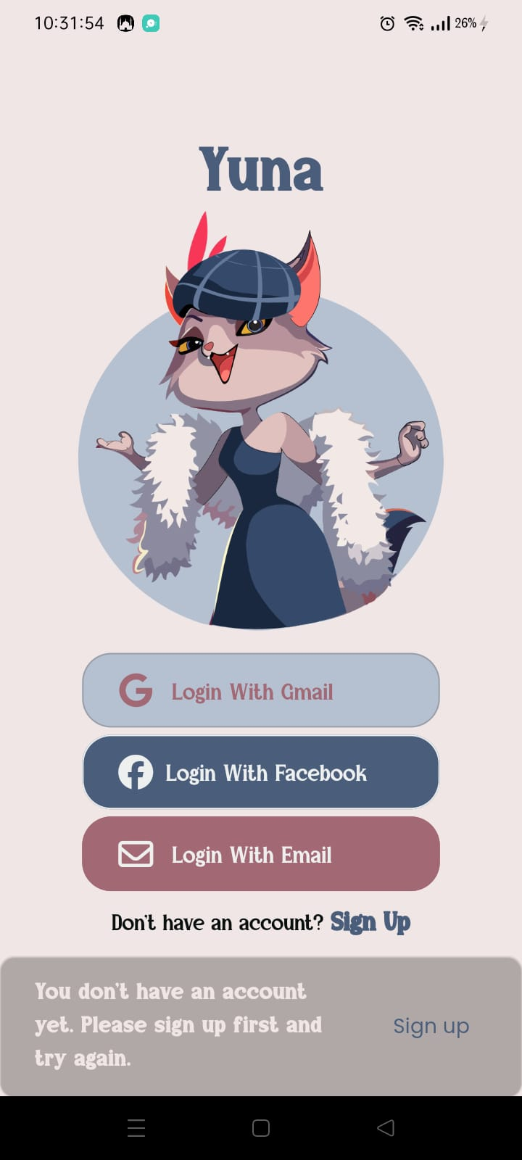
register pages

Slide 24
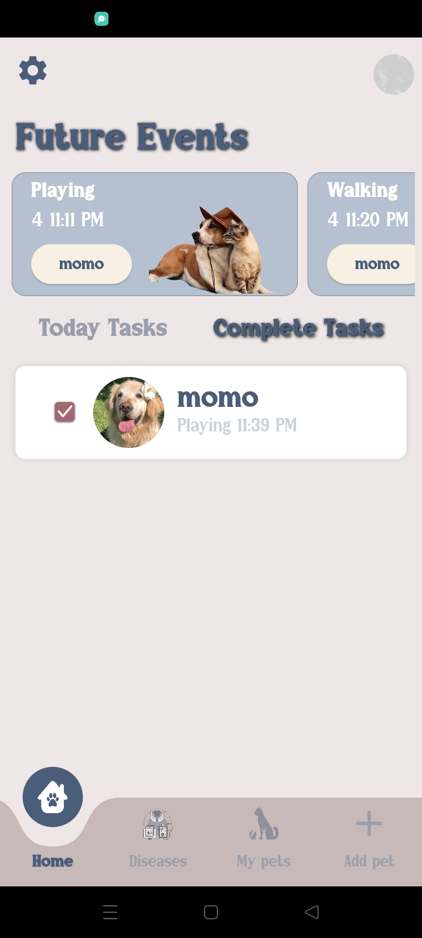
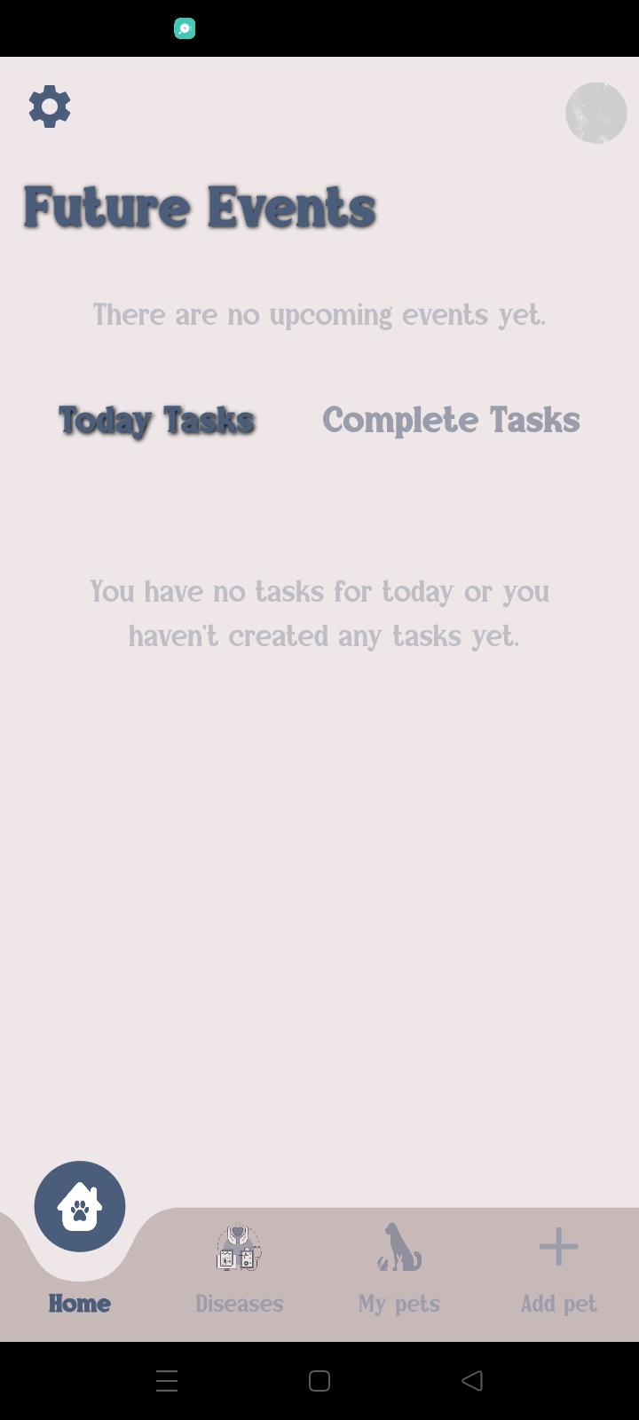
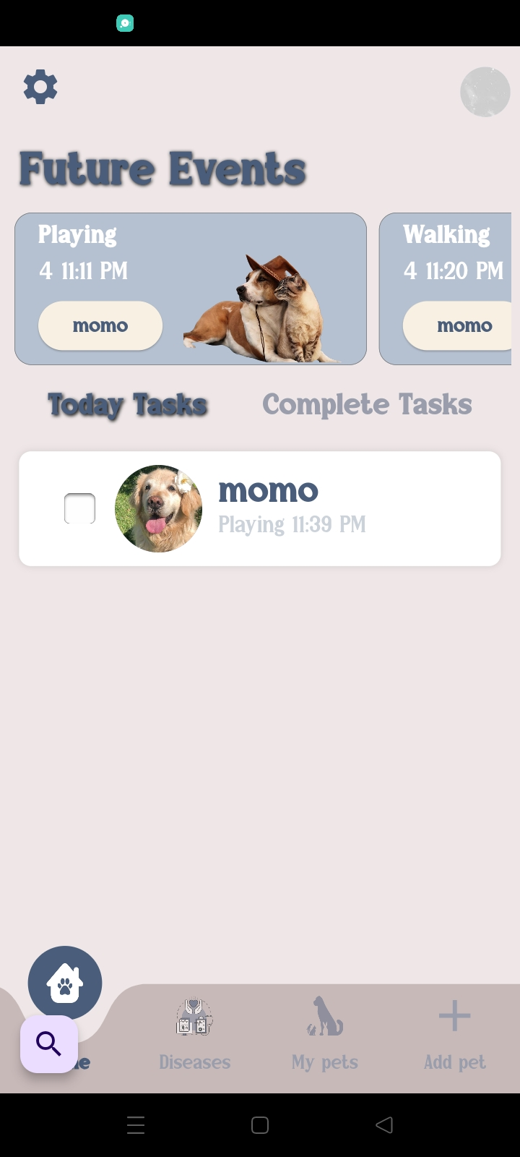
Home page

Slide 25
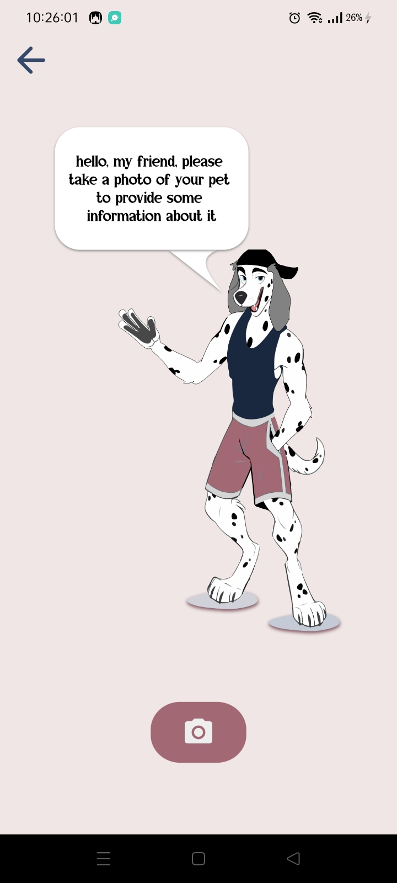
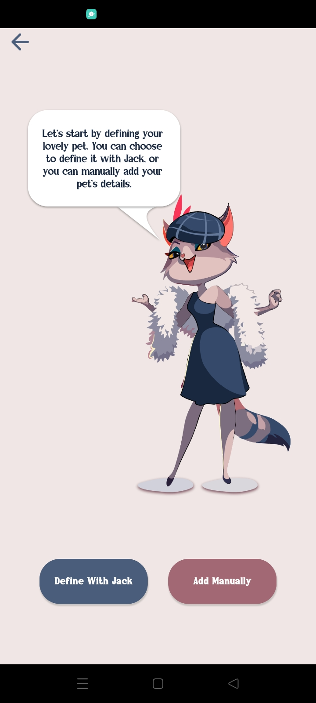
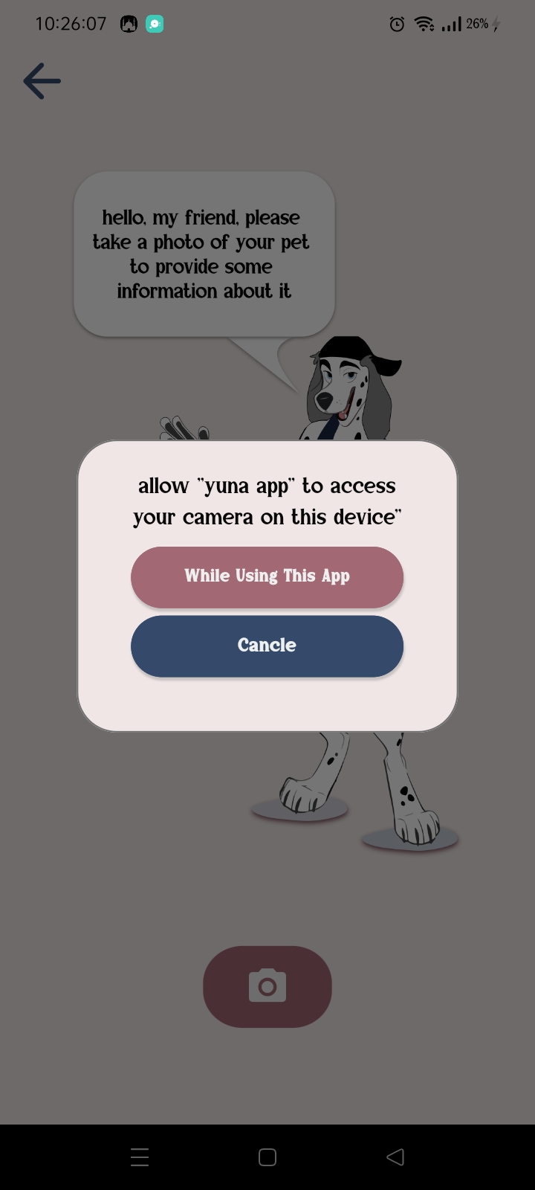
Define pages

Slide 26
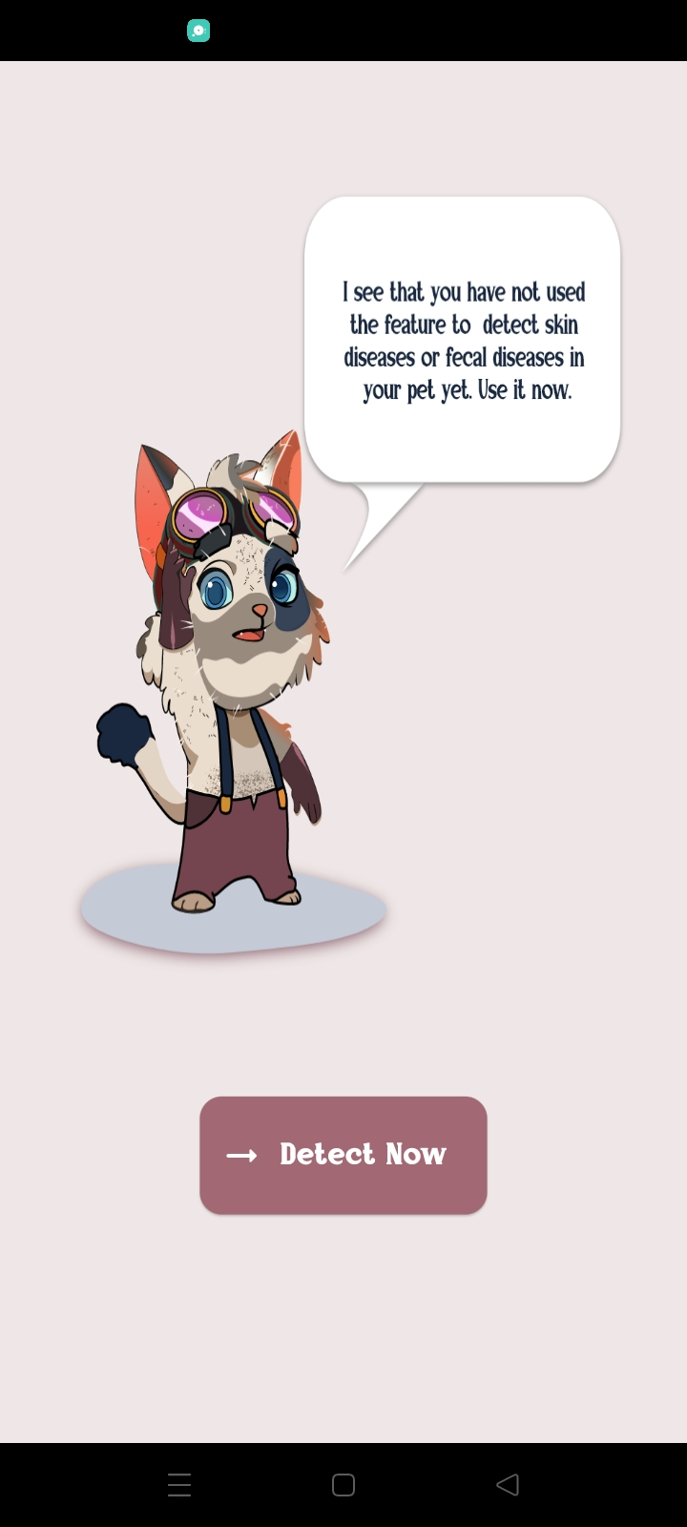
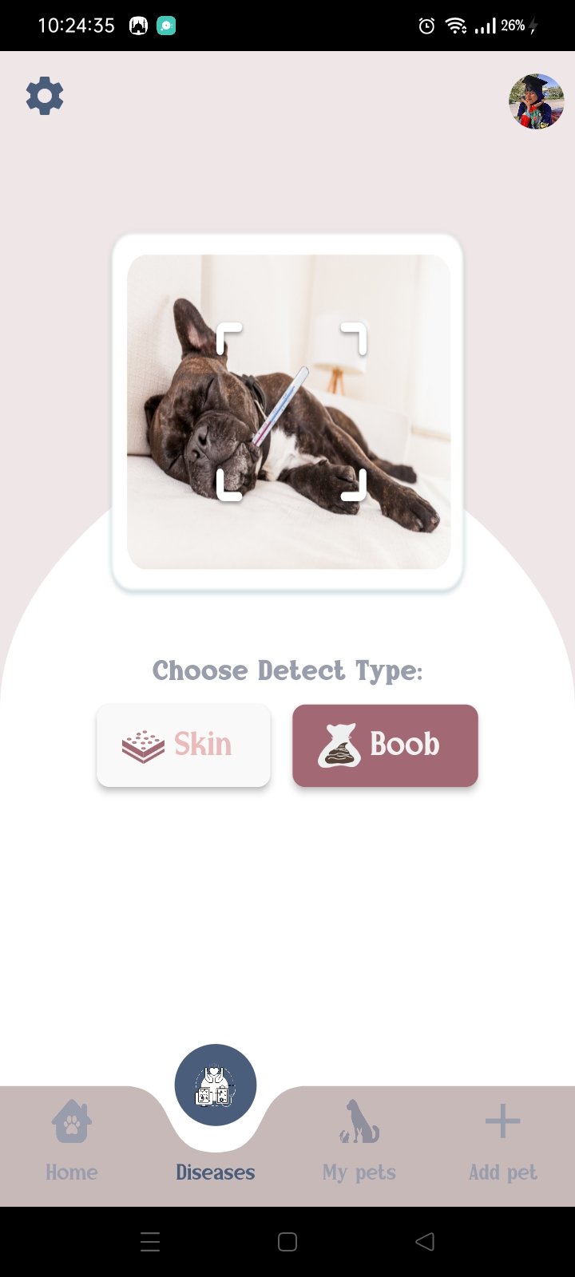
Detect disease page

Slide 27
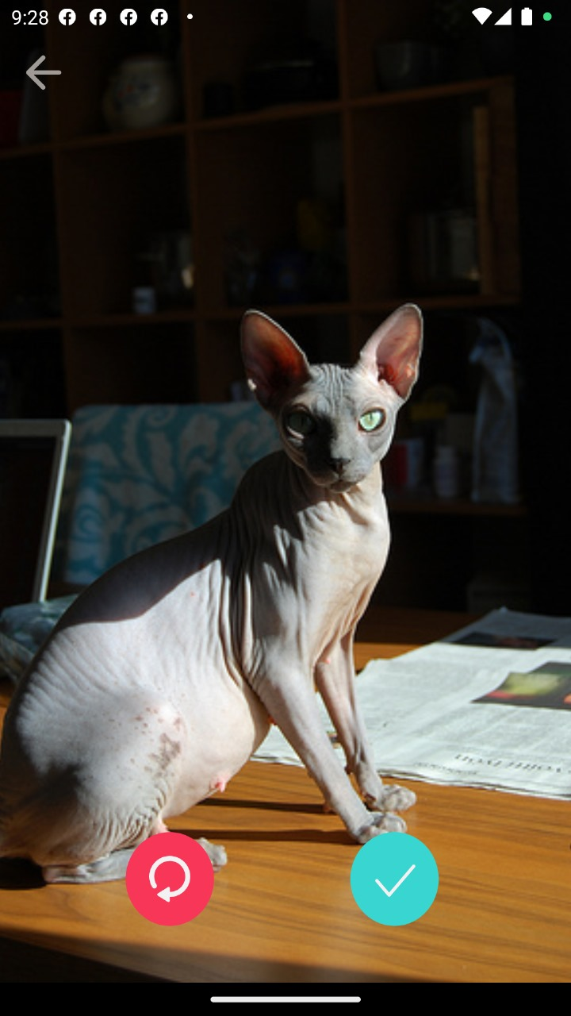
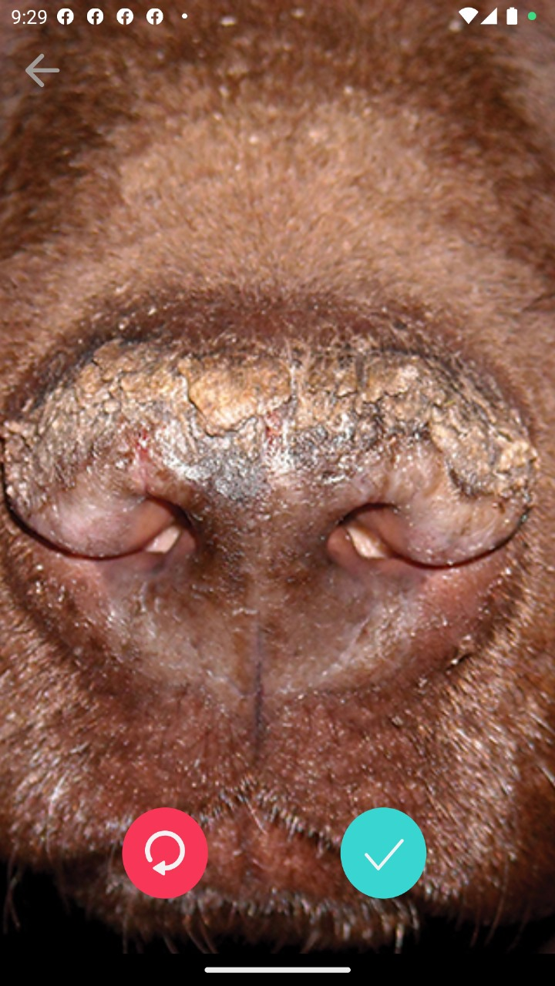
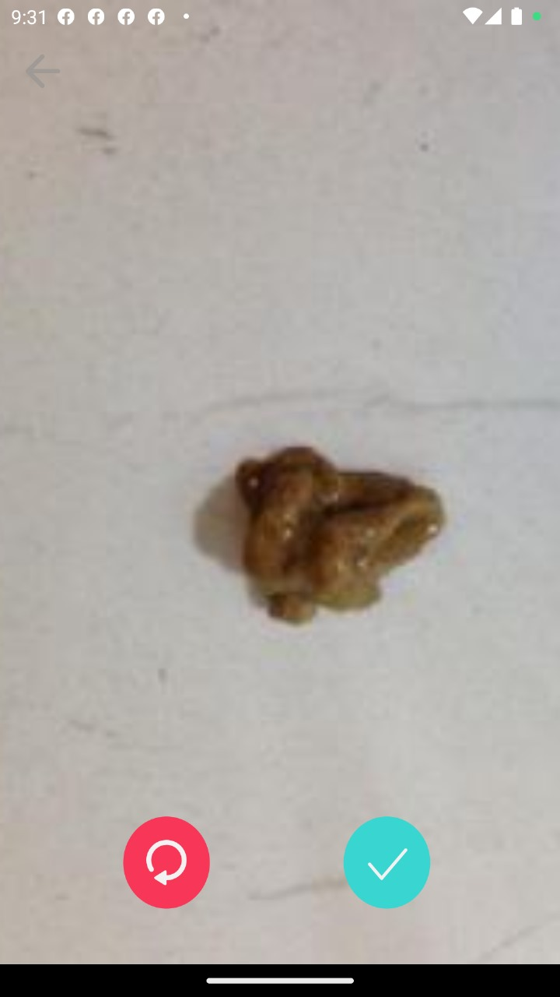
Pick images page

Slide 28
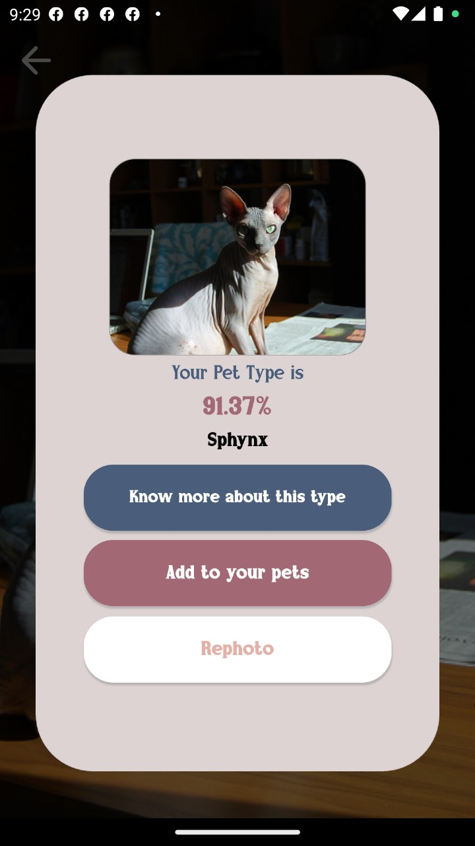
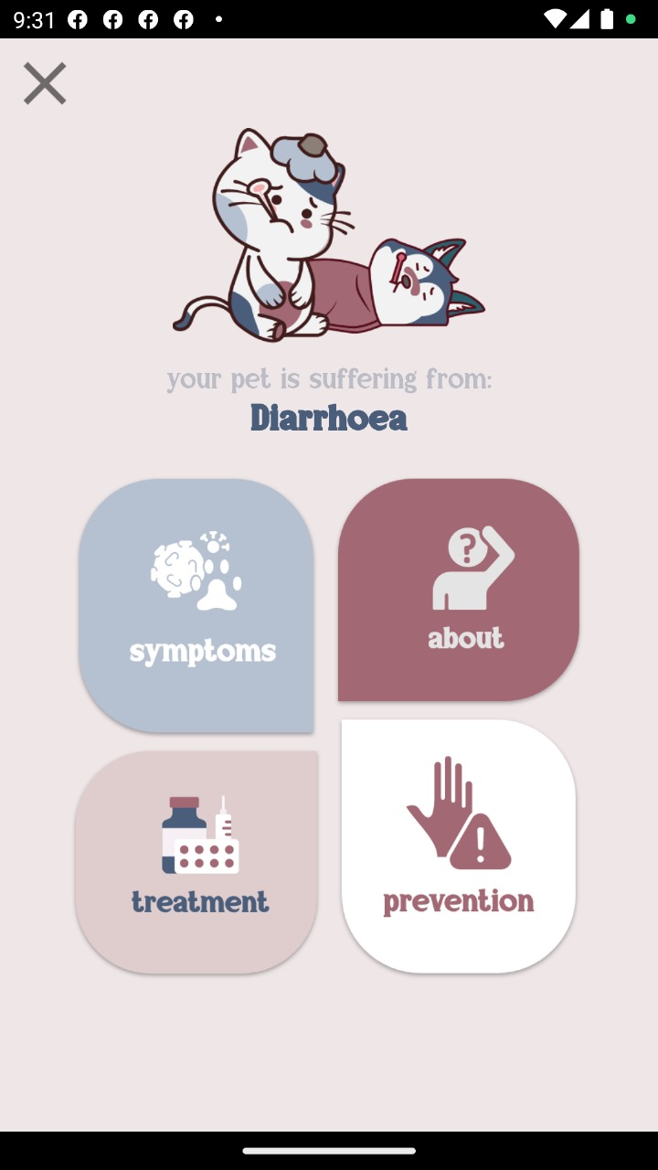

Detection Result pages

Slide 29
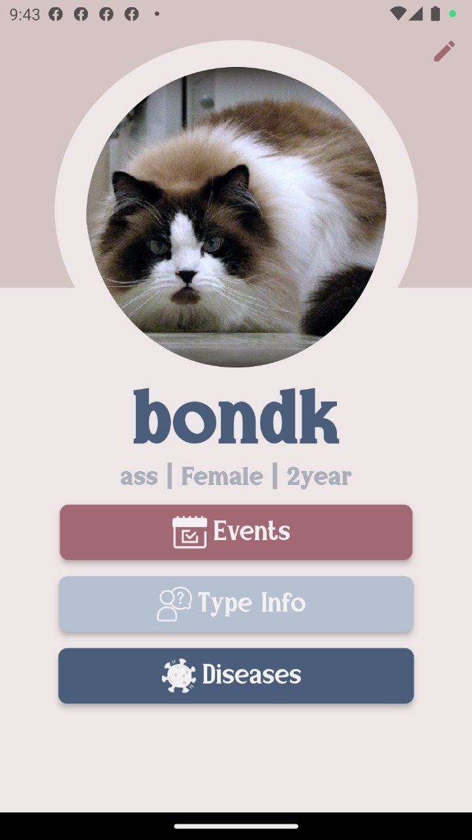
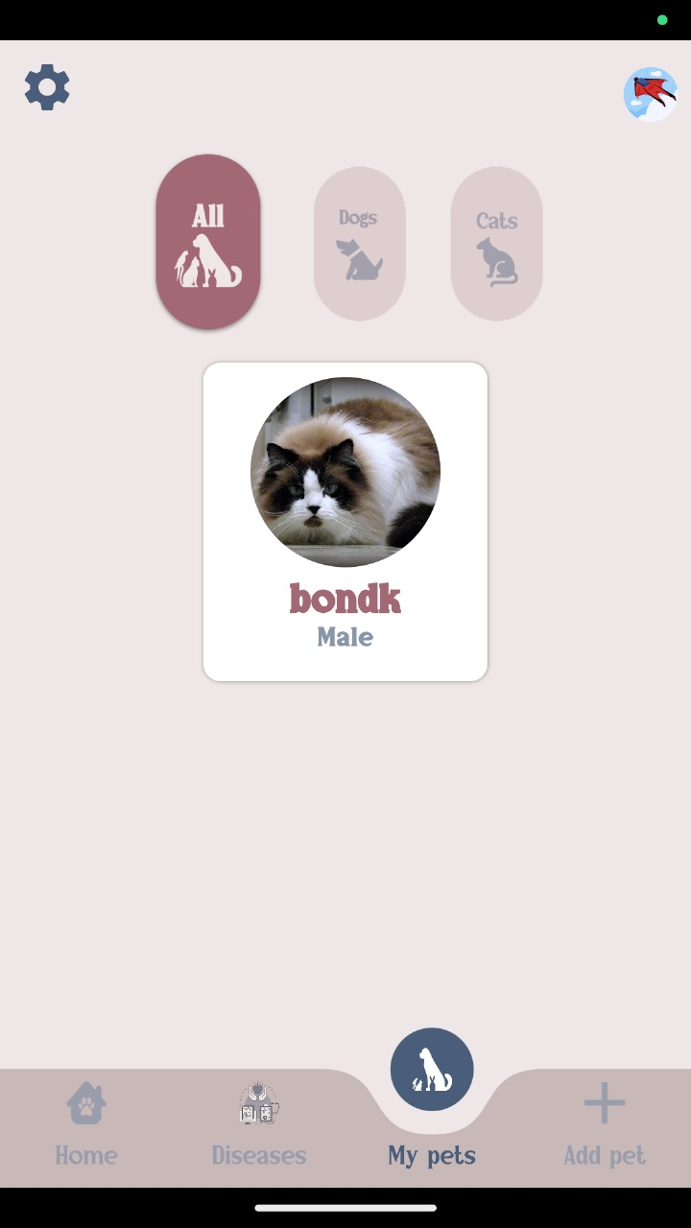
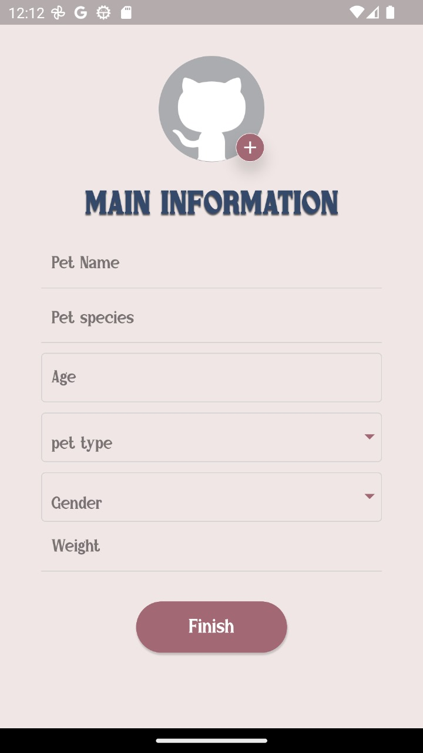
My pet pages

Slide 30
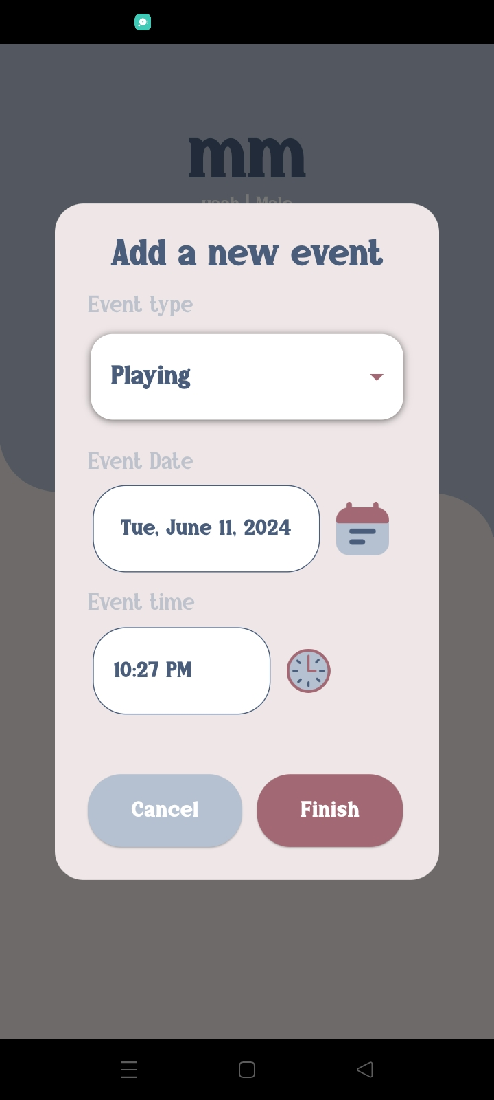
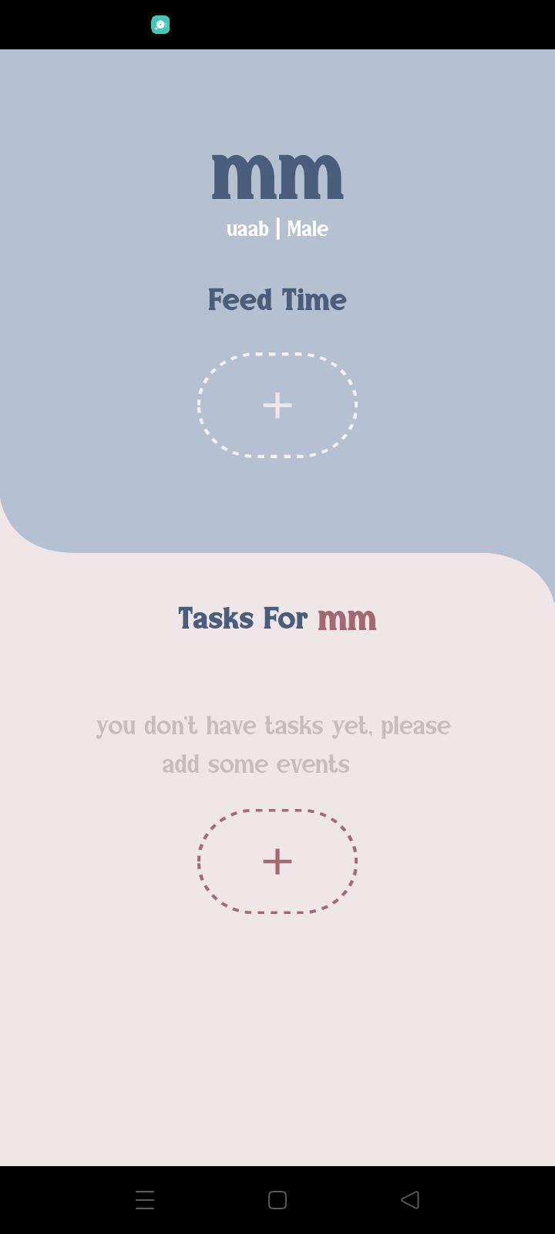
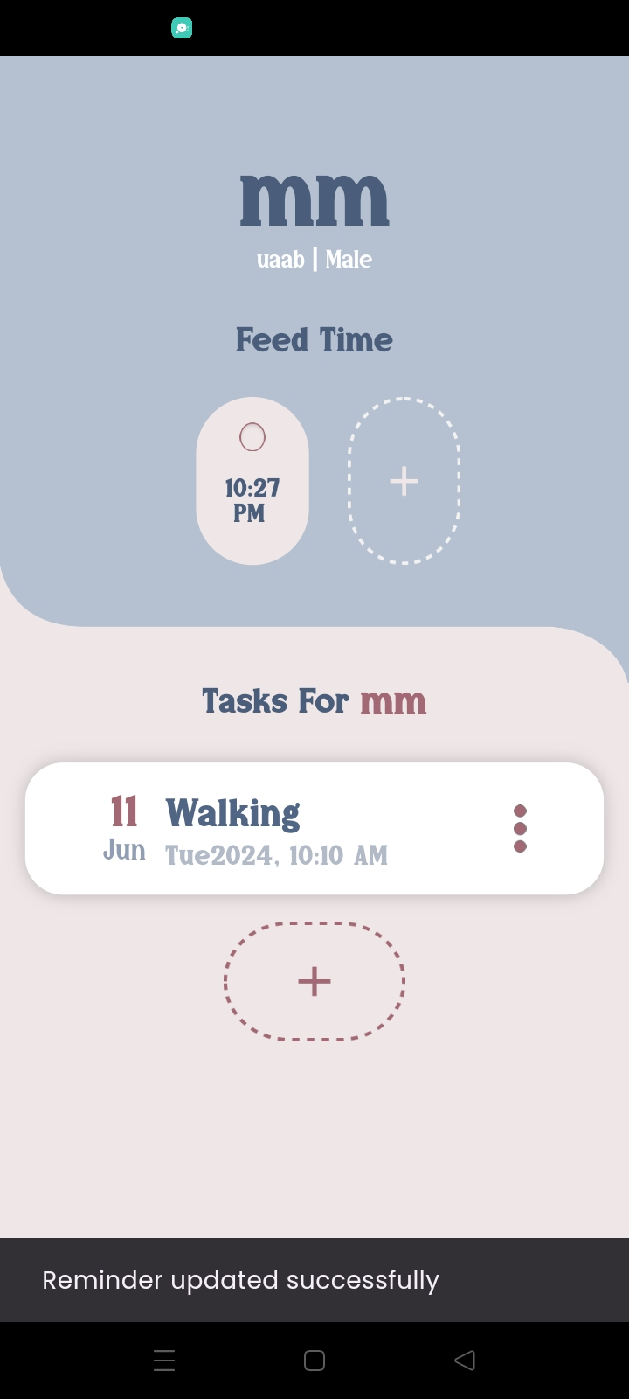
Reminder page

Slide 31
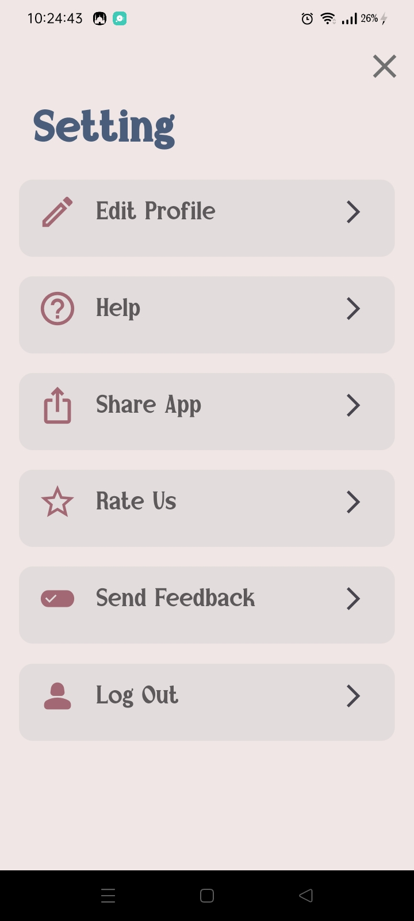
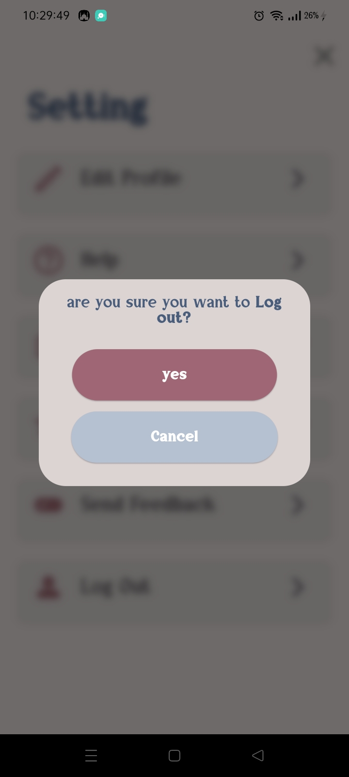
Setting page

Slide 32
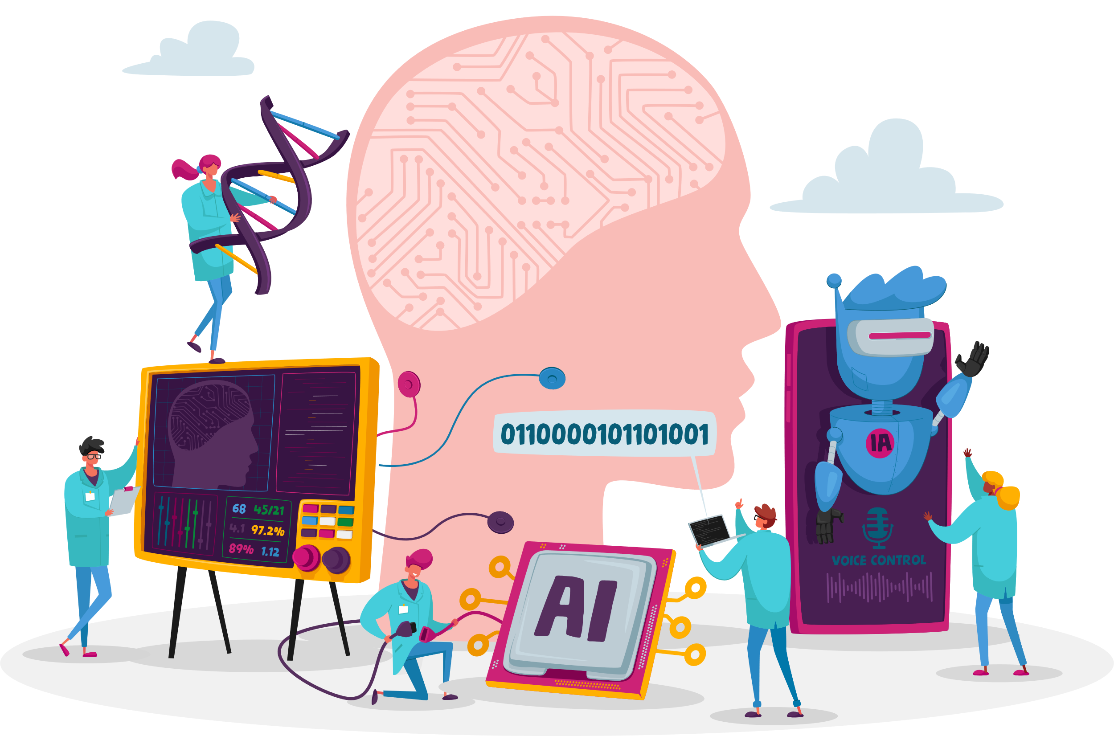
METHODOLOGY OF PROPOSED APPROACH

Slide 33
1- Machine Learning
PRE-TRAINED MODELS:​
pre-trained models for image detection include VGG16, VGG19, ResNet50, InceptionV3, and MobileNetV2, among others. These models serve as powerful tools for developers and researchers looking to incorporate advanced image detection capabilities into their projects with reduced training time and resources

Slide 34
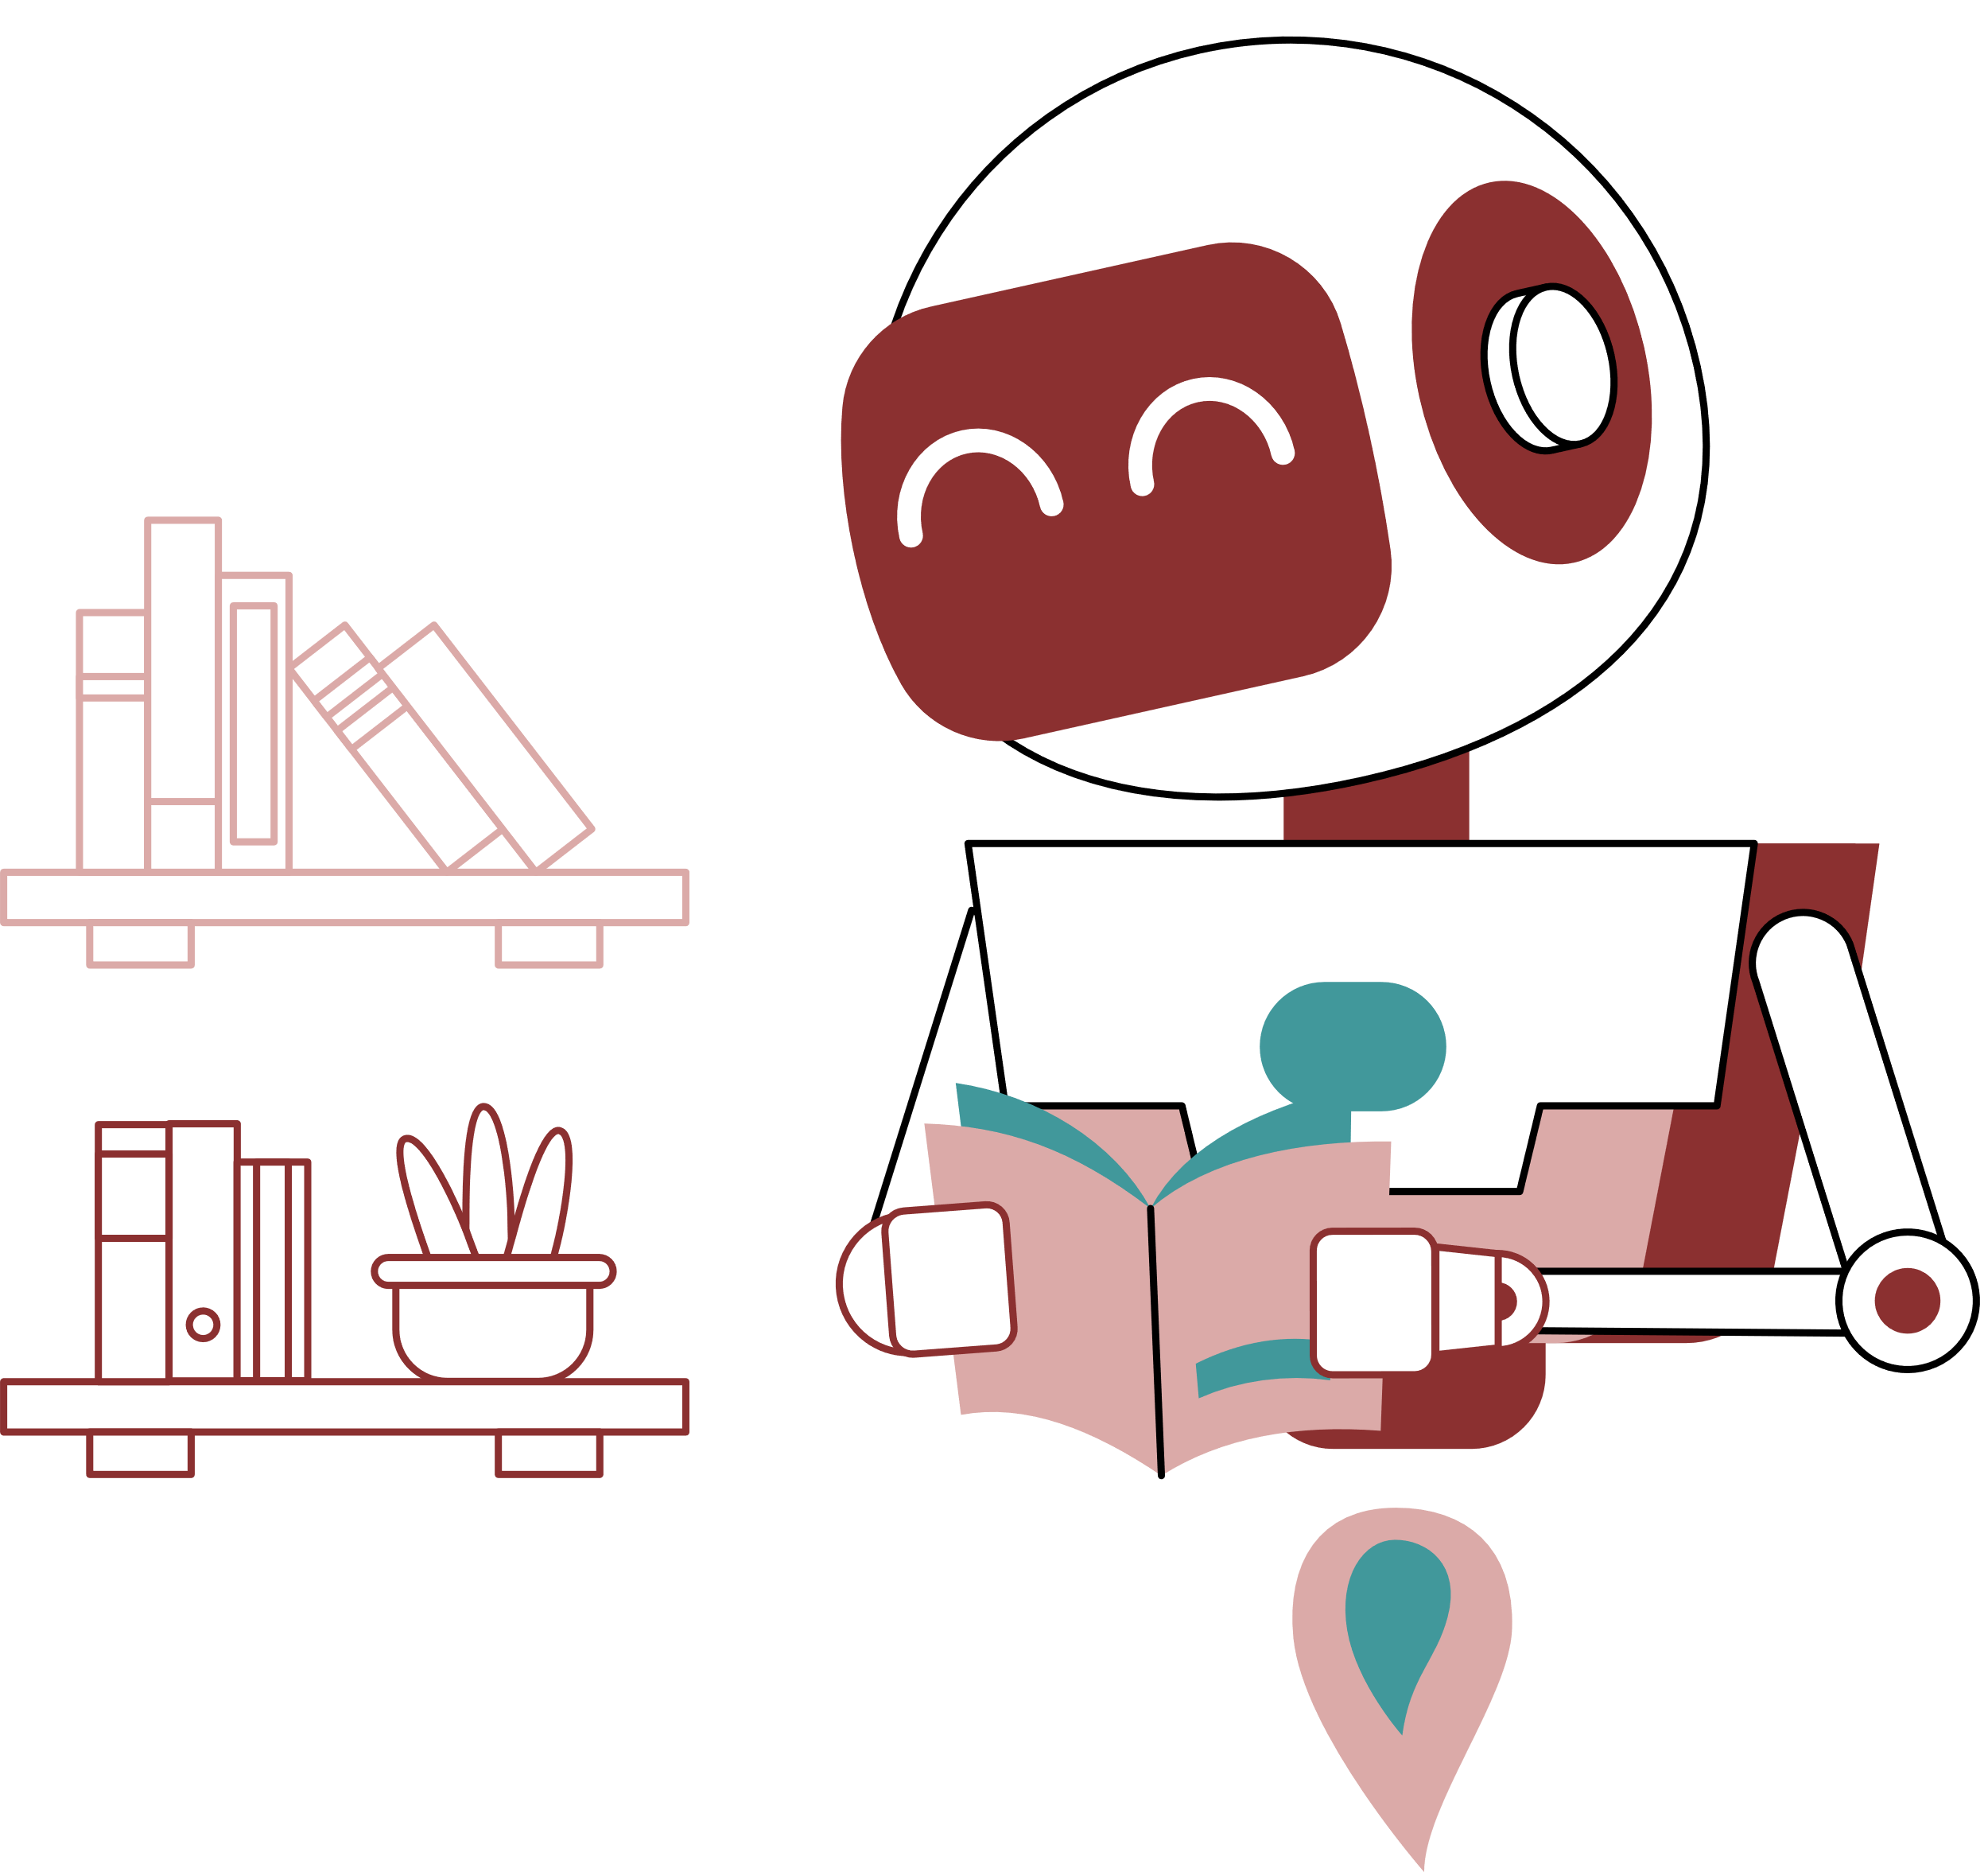
Used Algorithm in machine learning
MobileNet
MobileNet is a family of lightweight neural network architectures specifically designed for mobile and edge devices with resource constraints

Slide 35
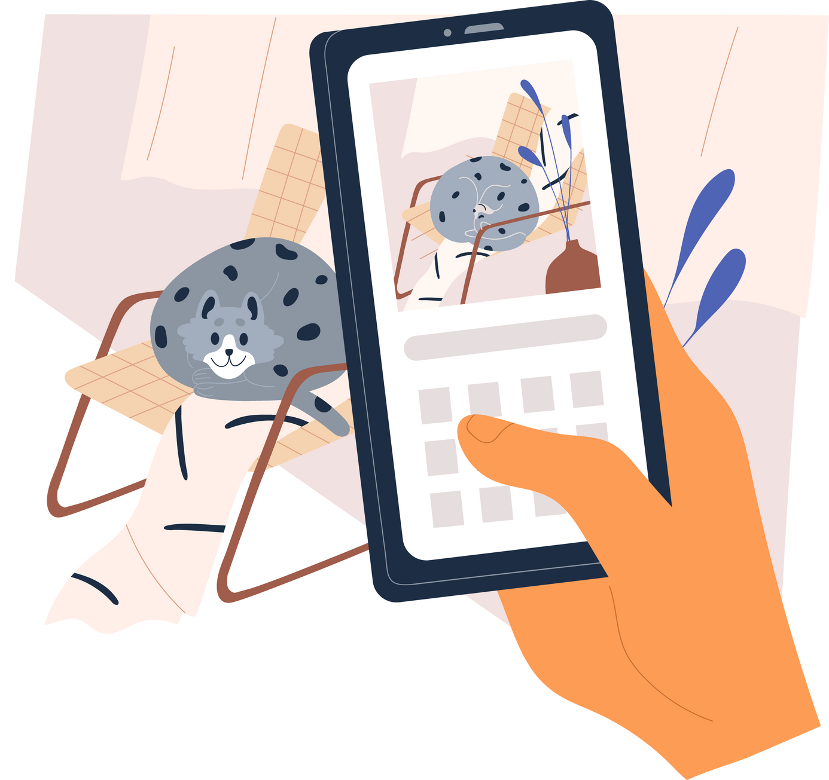
2-Hardware components
Mobile phone’s camera to capture photos of the pets and their diseases that need to be recognized.

Slide 36






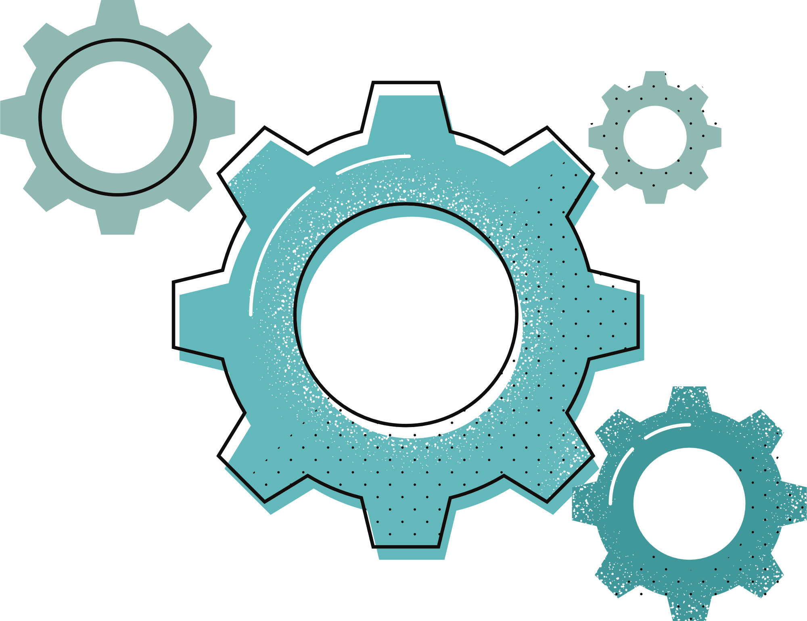

3-Software technique
Design
Front-End
Back-End
TOOLS
We use Adobe XD ​
For the design of the prototype
FLUTTER To create a basic application interface that interacts with the user
FIREBASE WITH CLOUD FIRESTORE
Use security rules to control access to data
​
GIT AND GITHUB
Git tracks changes in code, while GitHub uses Git for collaborative development.
​

Slide 37
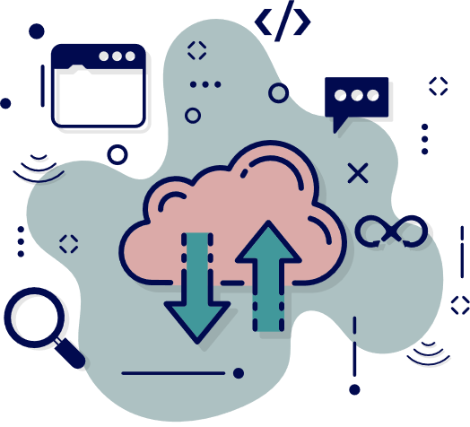
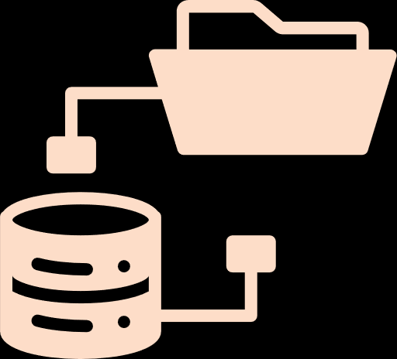

4-Source of data
Web Scraping
Dataset
Database
Web scraping involves extracting data from websites for content integration
organizations and research institutions provide publicly available image datasets for pet image detection
CLOUD FIRESTORE
offers a scalable, NoSQL database for storing and syncing data in real-time
​

Slide 38
About the datasets
Dataset for type detection
VGG Oxford Pet III-T Dataset
The VGG Oxford Pet III-T Dataset is a 37-category pet dataset containing roughly 200 images for each class, totally 7,400 images including both cats and dogs. The images exhibit significant variations in scale, pose, and lighting, making the dataset suitable for various computer vision tasks such as image classification, object detection, and segmentation. Each image in the dataset is annotated with a breed label and a ground truth segmentation mask, which provides pixel-level information about the pets in the images

Slide 39
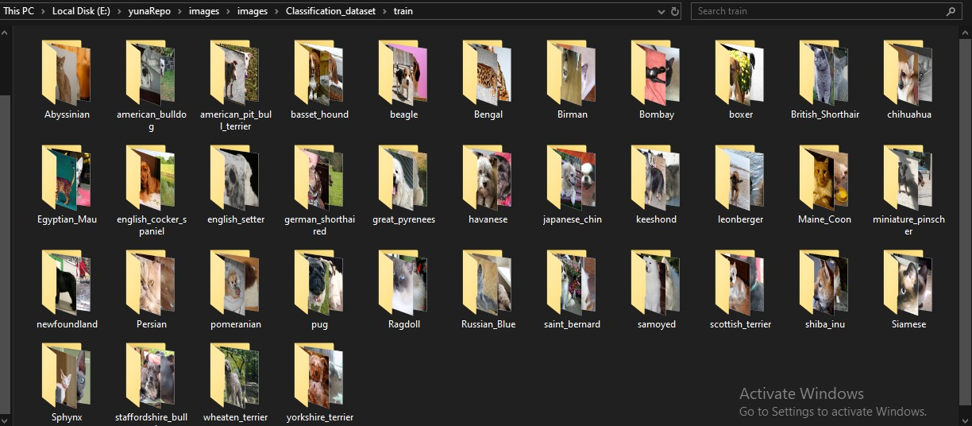
Dataset for type detection.cont
VGG Oxford Pet III-T Dataset photos

Slide 40
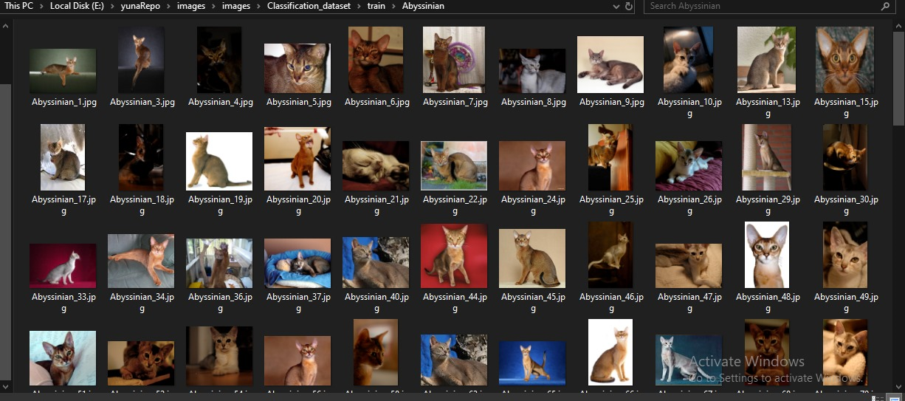
Dataset for type detection cont.
VGG Oxford Pet III-T Dataset photos

Slide 41
About the datasets
Dataset for skin diseases detection
The dog skin dataset
we found a data set that contained 3 diseases and another that contained 4 diseases. Therefore, we combined the two so that we could work on a larger number of diseases . These diseases are Bacterial dermatosis, Fungal infections, and Hypersensitivity allergic dermatosis. And healthy, keratosis, nasal discharge, and skin lesions, and the result of the merging became the data that we are working on, about15,532 images .

Slide 42
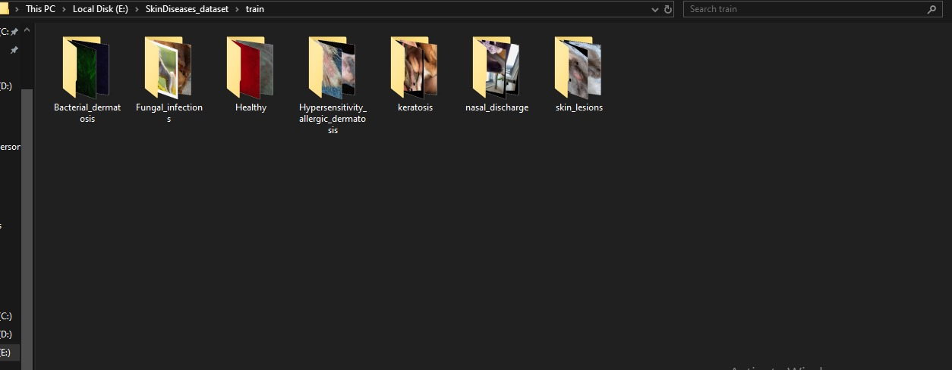
Dataset for skin diseases detection cont.
The dog skin dataset photos

Slide 43

Dataset for skin diseases detection cont.
The dog skin dataset photos

Slide 44

Dataset for skin diseases detection cont.
The dog skin dataset photos

Slide 45
About the datasets
Dataset for stool diseases detection
The dog stool diseases dataset
Divided into four categories: diarrhoea , lack of water , normal and soft Poop , It has approximately 1,620 images for poop diseases in dogs.
Note:
We have applied augmentation on the disease datasets to optimize for mobile net models and achieve maximum accuracy.

Slide 46

Dataset for stool diseases detection.cont
The dog stool diseases dataset photos

Slide 47

Dataset for stool diseases detection.cont
The dog stool diseases dataset photos

Slide 48

Dataset for stool diseases detection.cont
The dog stool diseases dataset photos

Slide 49
Deployment
Introduction to Flask
What is Flask?
Flask is a lightweight, micro web framework for Python.
Designed to be simple and easy to get started with, but highly scalable.
It is based on Werkzeug WSGI toolkit and Jinja2 template engine.
Ideal for developing small to medium web applications and APIs.
Diagram illustrating Flask as a bridge between the backend (server-side logic) and the frontend (client-side applications).
Screenshot of a simple Flask app code snippet.

Slide 50
Deployment cont.
Why Use Flask in a Flutter Project?
Seamless API Integration:
Flask can serve as an API provider, allowing Flutter apps to communicate with the backend.
Easily handles HTTP requests and responses.
Lightweight and Efficient:
Flask is minimalistic, making it fast and efficient for mobile applications.
Supports quick development cycles and easy debugging.
Flexibility and Extensibility:
Flask's modular design lets you incorporate various extensions for added functionality.
Perfect for integrating machine learning models with mobile apps.

Slide 51
Deployment cont.
Flask with MobileNet for Pet Detection and Disease Diagnosis
Role of Flask:
Hosts the MobileNet model and provides endpoints for image processing.
Receives images from the Flutter app, processes them, and returns the results.
Role Of Flask
Real-time image analysis with efficient API responses.
Scalable solution to handle multiple requests simultaneously.
Diagram showing the Flutter app sending images to the Flask server and receiving diagnosis results.
Example of pet type and disease detection workflow.

Slide 52


Let's stop for 5 minutes to present our demo work.

Slide 53

TIME PLAN

Slide 54
future work
feature
# 1
feature
# 2
Develop a feature with AI that discovers and provides detailed information about different types of all pets
Integrating an AI system that detects potential health issues in cats by analyzing the characteristics of their feces and their skin diseases.

Slide 55
future work cont.
feature
# 3
Other features
Adding Arabic language to the application.
Adding a community for a pet lovers like a Facebook but for users of this app.
Add a store that sells pet care supplies.
Adding notifications to help the user remember tasks such as playing , feed time , walking and medical checkup.

Slide 56

Conclusion
In conclusion, our pet care app offers a seamless and enriching experience for modern pet owners. It provides a holistic approach to pet care, fostering a sense of community and support.
Embrace a new era of simplified pet ownership with our intuitive and user-friendly application. Your furry friend deserves the best, and we're here to make it effortlessly accessible for you.

Slide 57

References
datasets resources
https://github.com/ZhouGuoXiong/MC-SCMNet
https://www.kaggle.com/datasets/paulopinheiro/vgg-oxford-pet-iii-t-dataset/data
https://www.kaggle.com/datasets/yashmotiani/dogs-skin-disease-dataset
https://universe.roboflow.com/shimalka-yohan/dog-disease-detection/browse?queryText=&pageSize=50&startingIndex=0&browseQuery=true
sources of statistics :
https://www.healthforanimals.org/reports/pet-care-report/global-trends-in-the-pet-population/#ownership
https://www.forbes.com/advisor/pet-insurance/pet-ownership-statistics/
https://www.gfk.com/insights/mans-best-friend-global-pet-ownership-and-feeding-trends

Slide 58
References cont.
Scrapping resources
https://www.msdvetmanual.com/immune-system/immunologic-diseases/hypersensitivity-diseases-in-animals#Immune-Mediated-Arthritis_v48829523
https://www.msdvetmanual.com/dog-owners/disorders-affecting-multiple-body-systems-of-dogs/fungal-infections-in-dogs
https://www.vscot.com/site/blog/2020/12/03/diagnose-treat-fungal-infections-in-dogs
https://www.guilfordjamestownvet.com/site/blog-greensboro-vet/2020/11/30/bacterial-fungal-skin-infections-dogs
https://https://www.akc.org/
https://www.purina.com/cats/cat-breeds/abyssinian-cat
https://www.trupanion.com/pet-blog/article/american-pit-bull-terrier

Slide 59
References cont.
Scrapping resources cont.
https://https://www.thesprucepets.com/
https://en.wikipedia.org/wiki/Main_Page
https://www.petmd.com/
https://www.purina.co.uk/
Articles
https://www.healthforanimals.org/reports/pet-care-report/global-trends-in-the-pet-population/#ownership
https://www.hindawi.com/journals/js/2023/5602595/

Slide 60
Project link
https://github.com/soo20/petapplication

Slide 61


